Slide 1
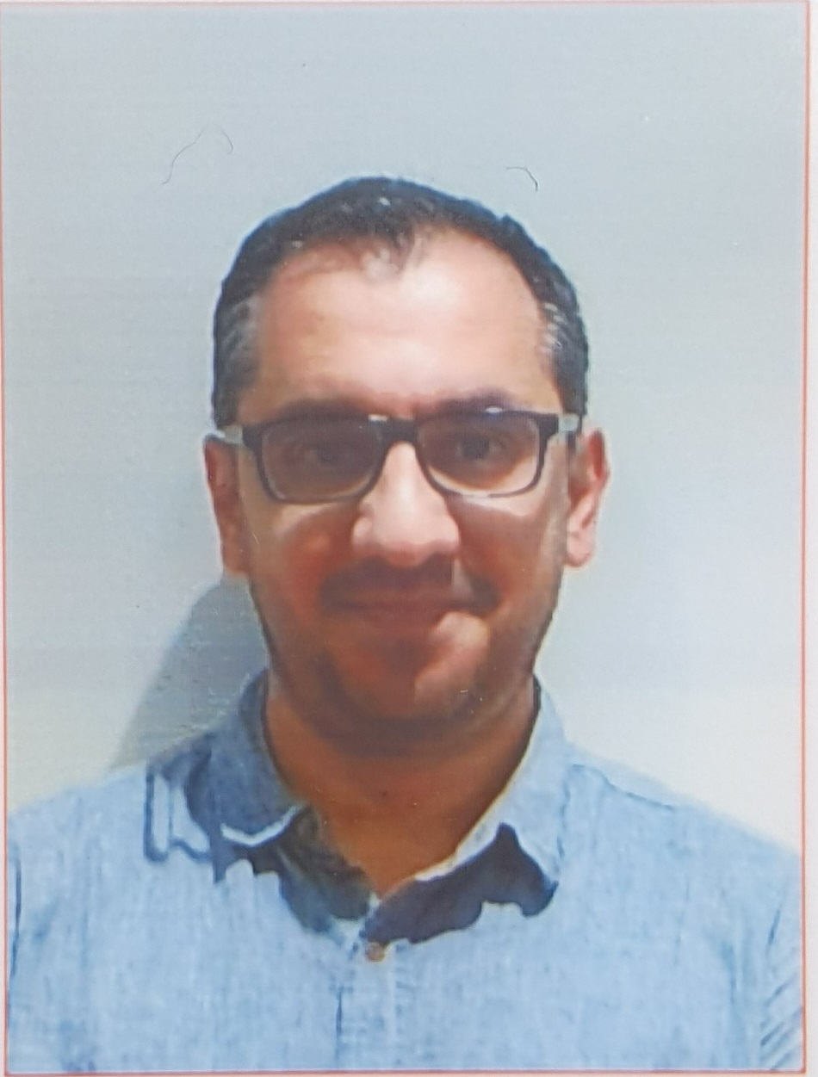
Introduction to Software Engineering (ISE102) Tutorial Week 1

Slide 2
Welcome to 32555 – Fundamentals of Software Development
Your Teaching Team:
Dr. Yining Hu – Subject Coordinator
Dr. Farshid Keivanian – Tutor
Dr. Hasan Khattak – Tutor
Xiaojie (Zoe) Lin – Tutor

Slide 3
Welcome to 32555 – Fundamentals of Software Development
What You’ll Learn:
Fundamentals of software development
Object-Oriented Programming (OOP) using Java or Python
UML modeling & GUI applications
Software testing, collaboration, and version control (Git)
Tools Used: Visual Paradigm, Git, BlueJ / Eclipse / VSCode, Python 3.8+, JavaFX / Tkinter

Slide 4
Week 1 Expectations
Welcome everyone to 32555 – Fundamentals of Software Development. Whether you’ve coded before or this is your first time, this subject is designed to give you the foundations of software engineering using either Python or Java.
We’ll teach you how to think like a developer: analyze user needs, model your solution, write working code, test it, and work in a team using Git.
Please choose either Python or Java this week — you only need to use one language for the rest of the trimester. Labs, quizzes, and assessments will align with your choice.

Slide 5
Week 1 Expectations
By next week, I want you to have your IDE set up, Git configured, and be comfortable with UML tools.
Remember: don't just aim to pass — aim to build something meaningful and reusable for your portfolio.
I’ll be here to support you throughout. Let’s make it a great semester!

Slide 6
Week 1 Expectations
As a student, you are expected to:
Attend weekly 2-hour tutorials (on campus)
Watch online lectures and demos before each lab
Complete all practice quizzes and assignments on time
Communicate professionally via Canvas Inbox
Actively participate in group activities and contribute equally

Slide 7
Week 1 Expectations
Avoid:
Leaving labs or assignments until the last minute
Ignoring Canvas announcements or deadlines
Submitting without proper version control or testing

Slide 8
How to Succeed in 32555
Weekly Routine for Success:
Watch the week’s lecture video
Complete the practice quiz
Attend and participate in your tutorial
Review and reflect on feedback
Contribute to group activities and GitHub commits

Slide 9
How to Succeed in 32555
Pro Tips:
Pick one language (Java or Python) and stick with it
Use UML tools to map your ideas before coding
Use Git for version control from the start
Reach out if you’re stuck — don’t wait until it’s too late!

Slide 10
Key Assessment Dates – Spring 2025
Task | Opens | Due | Weight
Quiz 1: Software Modelling | 9 Sep 5:00 PM | 12 Sep 6:00 PM | 15%
Part 1: Analysis & Design | 18 Aug | 14 Sep 11:59 PM | 15%
Quiz 2: Programming (Java/Python) | 21 Oct 5:00 PM | 24 Oct 6:00 PM | 15%
Part 2: Software Development | 29 Sep | 9 Nov 11:59 PM | 50%
Part 3: Project Showcase | 29 Sep | 7 Nov 11:59 PM | 5%

Slide 11
Week 1 – Requirements Analysis
What are software requirements?
Functional vs. Non-functional requirements
Use Case Diagrams and System Requirements Specs
Introduction to UML: Use Case & Activity Diagrams

Slide 12
Week 1 – Requirements Analysis
Tutorial (Lab 1):
Hands-on activity: Analyze a real-world scenario
Draw a use-case diagram using Draw.io or Visual Paradigm
Discuss requirements with your team

Slide 13
Week 1 – Requirements Analysis
Deliverables This Week:
Complete Week 1 Practice Quiz on Canvas
Submit Lab 1 solution

Slide 14

Happy Learning and Bright Futures Ahead! Dr. Farshid Keivanian Stay Connected: linkedin.com/in/farshid-keivanian github.com/FarshidKeivanian
Education is the most powerful weapon you can use to change the world. — Nelson Mandela

